Slide 1
UNIT 1
Overview of Parallel Computers and high-performance computing (HPC), HPC paradigms - supercomputing, cluster computing, grid computing, cloud computing, Multi-core and GPU systems, petascale systems. Cluster computing: basics, architecture, classification, components.

Slide 2
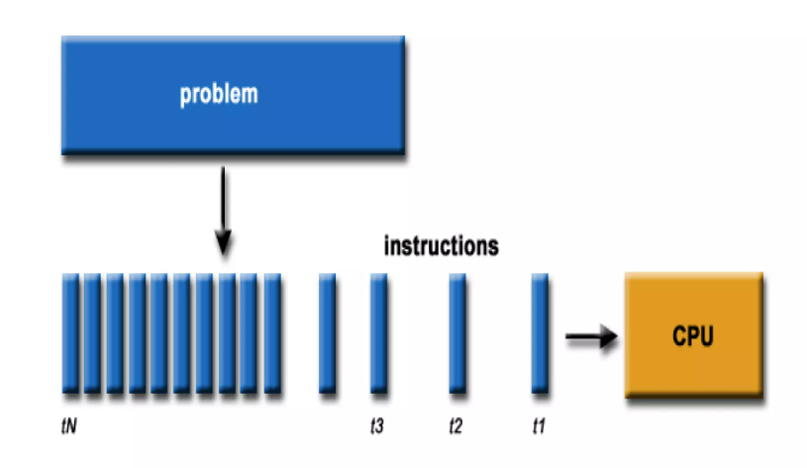
Parallel Computing
Traditionally - software written for serial communication
Single computer – single CPU
Instructions executed one after the other

Slide 3
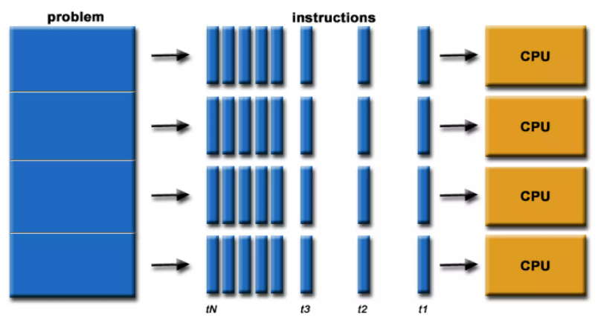
Parallel Computing
Parallel computing – form of computation in which the calculations are carried out simultaneously
(ie)– uses multiple resources to solve the problem
Run multiple CPUs
Broke the problem into pieces to solve concurrently
Instructions execute simultaneously on different CPUs

Slide 4
Why Parallel Computing
Parallel Computing
save time
solve larger problems
provide concurrency
use non-local resources
limits to serial computing
current computing architecture are relay upon hardware level parallelism to improve performance through:
multiple execution units
pipelined instructions
multicore

Slide 5
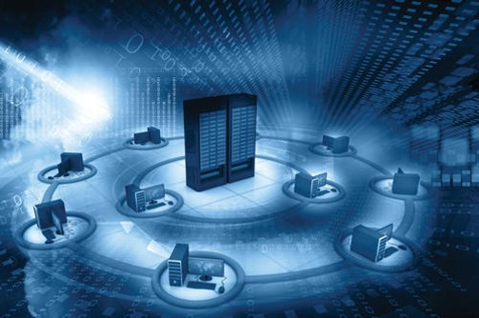
HIGH PERFORMANCE COMPUTING
High-performance computing (HPC) is the practice of using parallel data processing to improve computing performance and perform complex calculations. HPC achieves these goals by aggregating computing power, so even advanced applications can run efficiently, reliably and quickly as per user needs and expectations

Slide 6
HIGH PERFORMANCE COMPUTING
Why do we need HPC?
• Larger and more complex mathematical models require greater computer performance.
HPC is technology that uses clusters of powerful processors, working in parallel, to process massive multi-dimensional datasets (big data) and solve complex problems at extremely high speeds.
HPC systems typically perform at speeds more than one million times faster than the fastest commodity desktop, laptop or server systems.
Scientific computing is replacing physical models, for example.
• When computer performance increases new problems can be attacked.

Slide 7
HIGH PERFORMANCE COMPUTING
Importance of High performance Computing :
It is used for scientific discoveries, game-changing innovations, and to improve quality of life.
It is a foundation for scientific & industrial advancements.
It is used in technologies like IoT, AI, 3D imaging evolves & amount of data that is used by organization is increasing exponentially to increase ability of a computer, we use High-performance computer.
HPC is used to solve complex modeling problems in a spectrum of disciplines. It includes AI, Nuclear Physics, Climate Modelling, etc.
HPC is applied to business uses as well as data warehouses & transaction processing.

Slide 8
HIGH PERFORMANCE COMPUTING
What is high performance computing (HPC)?
The use of the most efficient algorithms on computers capable of the highest performance to solve the most demanding problems.
Why HPC?
Large problems – spatially/temporally
10,000 x 10,000 x 10,000 grid → 10^12 grid points → 4x10^12 double variables → 32x10^12 bytes = 32 Tera-Bytes.
Usually need to simulate tens of millions of time steps.
On-demand/urgent computing; real-time computing;
Weather forecasting; protein folding; turbulence simulations/CFD; aerospace structures; Full-body simulation/ Digital human …

Slide 9
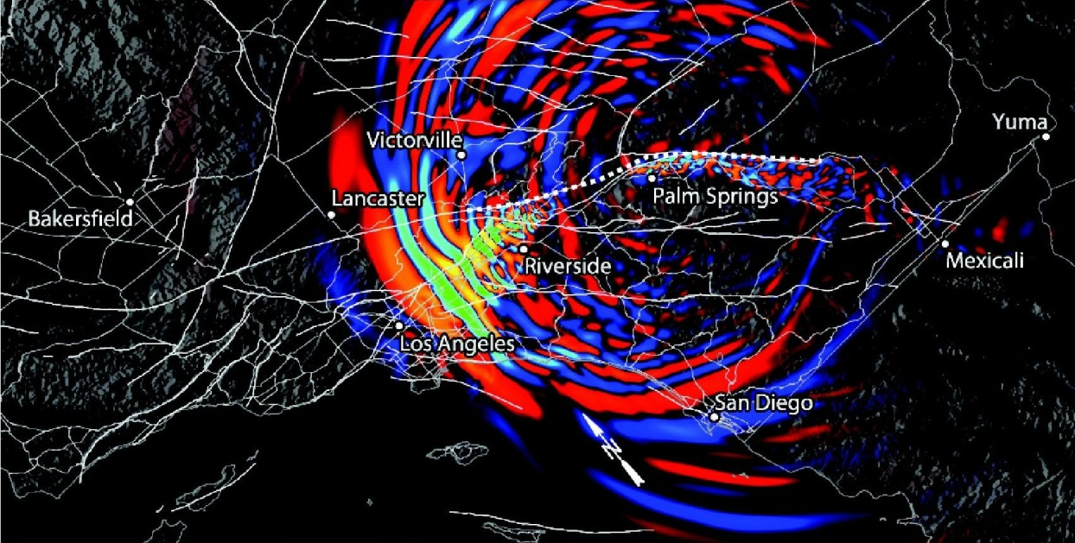

HPC Examples
HIGH PERFORMANCE COMPUTING
Earthquake simulation
Surface velocity 75 sec after earthquake
Flu pandemic simulation
300 million people tracked
Density of infected population, 45 days after breakout

Slide 10
HIGH PERFORMANCE COMPUTING
To solve problems in a reasonable time using available resources in a good way we need competence in the following areas:
algorithms
hardware; limitations and possibilities
code optimization
parallelization and decomposition of problems and algorithms
software tools

Slide 11
HPC Paradigms
The implementation of algorithms on parallel computers is to a large extent dependent on the target architecture.
So before we can investigate algorithms that can take effective advantage of parallelism, it is necessary to consider how a parallel computer operates.
There are two main ways in which computers can be organized to perform computations in parallel:
• Shared memory
• Distributed memory (message passing)

Slide 12
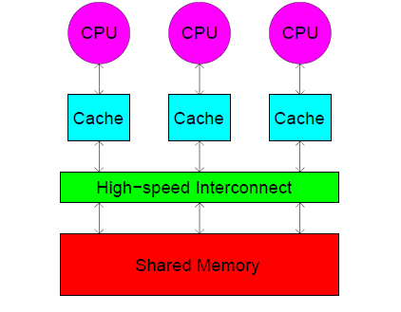
HPC Paradigms
Shared-memory paradigm
Shared-memory computers have multiple processors that share access to a global memory space via a high-speed memory bus.
This global memory space allows the processors to efficiently exchange or share access to data.
Multiple processors can operate independently but share the same memory resources.
Changes in a memory location effected by one processor are visible to all other processors.
The number of processors used in shared-memory architectures is usually limited because the amount of data that can be processed is limited by the bandwidth of the memory bus connecting the processors
Shared memory machines can be divided into two main classes based upon memory access times UMA and NUMA.

Slide 13
HPC Paradigms
Shared Memory :UMA vs. NUMA
Uniform Memory Access (UMA)
Most commonly represented today by Symmetric Multiprocessor (SMP) machines
Identical processors
Equal access and access times to memory
Sometimes called CC-UMA - Cache Coherent UMA. Cache coherent means if one processor updates a location in shared memory, all the other processors know about the update. Cache coherency is accomplished at the hardware level.
Non-Uniform Memory Access (NUMA)
Often made by physically linking two or more SMPs
One SMP can directly access memory of another SMP
Not all processors have equal access time to all memories
Memory access across link is slower
If cache coherency is maintained, then may also be called CC-NUMA - Cache Coherent NUMA

Slide 14
HPC Paradigms
Shared Memory : Pro and Con
Advantages
Global address space provides a user-friendly programming perspective to memory
Data sharing between tasks is both fast and uniform due to the proximity of memory to CPUs
Disadvantages
Primary disadvantage is the lack of scalability between memory and CPUs. Adding more CPUs can geometrically increases traffic on the shared memory-CPU path, and for cache coherent systems, geometrically increase traffic associated with cache/memory management.
Programmer responsibility for synchronization constructs that insure correct access of global memory.
Expense it becomes increasingly difficult and expensive to design and produce shared memory machines with ever increasing numbers of processors.

Slide 15
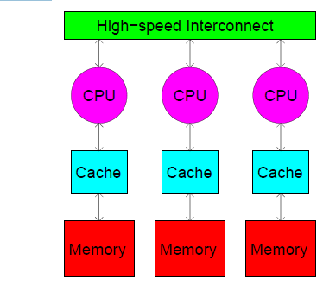
HPC Paradigms
Distributed-memory paradigm
Distributed-memory parallel computers are essentially a collection of serial computers (nodes) working together to solve a problem.
Processors have their own local memory. Memory addresses in one processor do not map to another processor, so there is no concept of global address space across all processors.
Each node has rapid access to its own local memory and access to the memory of other nodes via some sort of communications network, usually a high-speed communications network (or “interconnect”).
Distributed memory systems require a communication network to connect inter-processor memory.
Data are exchanged between nodes as messages over the network.
Changes it makes to its local memory have no effect on the memory of other processors. Hence, the concept of cache coherency does not apply.
Synchronization between tasks is likewise the programmer's responsibility.
The network fabric used for data transfer varies widely, though it can be as simple as Ethernet.

Slide 16
HPC Paradigms
Distributed Memory: Pro and Con
Advantages
Memory is scalable with number of processors. Increase the number of processors and the size of memory increases proportionately.
Each processor can rapidly access its own memory without interference and without the overhead incurred with trying to maintain cache coherency.
Cost effectiveness can use commodity, off-the-shelf processors and networking.
Disadvantages
The programmer is responsible for many of the details associated with data communication between processors.
It may be difficult to map existing data structures, based on global memory, to this memory organization.
Non-uniform memory access (NUMA) times

Slide 17
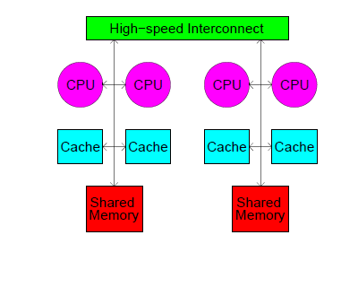
HPC Paradigms
Hybrid-memory paradigm
The latest generation of parallel computers now uses a mixed shared/distributed memory architecture.
Each node typically consists of a group of 2 to 16 processors connected via local shared memory, and the multiprocessor nodes are, in turn, connected via a high-speed interconnect.
The shared memory component is usually a cache coherent SMP machine. Processors on a given SMP can address that machine's memory as global.
The distributed memory component is the networking of multiple SMPs. SMPs know only about their own memory - not the memory on another SMP. Therefore, network communications are required to move data from one SMP to another.

Slide 18
HPC Paradigms
Shared vs. Distributed
Some facts of life:
• Distributed-memory systems are more prevalent than shared-memory systems; hybrid-memory systems are becoming increasingly popular.
• Message-passing programs can execute on either distributed or shared-memory systems; shared- memory programs can only execute on shared- memory systems.
• Shared-memory programming is relatively easy; message passing is less so. For better or worse, this means the programmer has more fine-tune control on the program and can potentially handle more complicated tasks.
• Message-passing programs often outperform shared- memory programs even when run on a shared- memory system.

Slide 19
High Performance Computing
Year | Computing | Introduced by | Example
1950 | Multi-Processors Systems
1960-80 | Supercomputers | Seymour Cray | Belle, Deep Blue, and Hydra for playing chess, Deep Crack for breaking the DES cipher.
1988 | Reconfigurable Computing
1990 | Cluster Computers | Gene Amdahl of IBM | Google search engine, Earthquake Simulation, Petroleum Reservoir Simulation
1998 | Distributed Computing
1999 | GPU Systems | Nvidia - Geforce 256. | Advanced Micro Devices (AMD) and Nvidia (NVDA)
2000 | Grid Computing | Foster and Kesselman | meteorologists use grid computing for weather modeling.
2001-2006 | SOA and Web Services, Deep Computing, Multi-Core Architecture, Skeleton Based | Intel and AMD released the first multicore processors. | Intel Core i9 12900 family provides 8 cores and 24 threads.
 | Programming, Network Devices
2008 | Cloud Computing | Google CEO Eric Schmidt | Dropbox, Gmail, Facebook.
2008-2009 | Petascale Computing | IBM | Roadrunner, Jaguar
2009-15 | Heterogeneous Multicore General-Purpose computing on Graphics Processing Units (GPGPU), APU, Big Data
The evolution of various computing or systems is as follows.

Slide 20
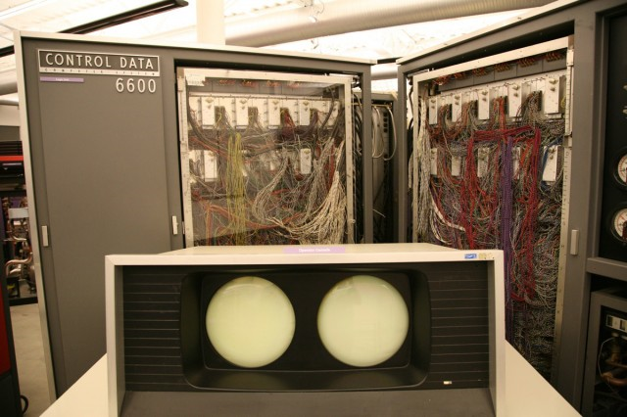
Computing Systems - Super computers
The term is commonly applied to the fastest high-performance systems in existence at the time of their construction
Typically multi core
Housed in large clean rooms with high air flow to permit cooling
Used to solve problems that are too massive for standard computers
Supercomputers speed are measured in floating point operations per second (FLOPS) in units of :  megaflops (MFLOPS)
❑ gigaflops (GFLOPS)
❑ teraflops (TFLOPS)
12 data channels, 10 peripheral processors, a central magentic-core memory and a central processor
CDC 6600 first Super computer

Slide 21
Computing Systems - Super computers
ARCHITECTURE
Two major methods of parallel processing in supercomputer are
SIMD – Single Instruction Streams Multiple Data Streams : A SIMD processor executes the same instruction on more than one set of data at the same time
MIMD – Multiple Instruction Streams Multiple Data Streams is employed to achieve parallelism, by using a number of processors that function asynchronously and independently

Slide 22
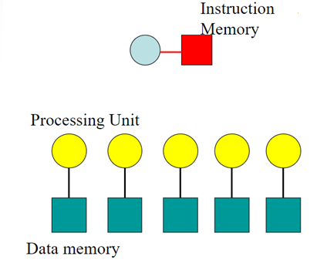
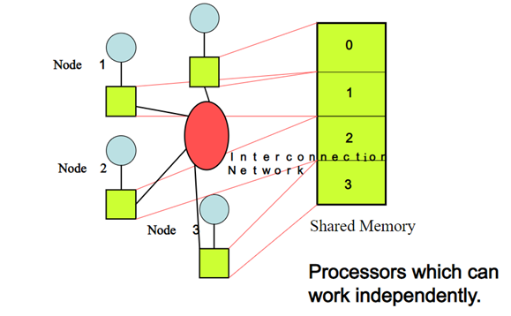
Computing Systems - Super computers
SIMD MIMD
Node 4

Slide 23
S.NO | SIMD | MIMD
1. | SIMD stands for Single Instruction Multiple Data. | While MIMD stands for Multiple Instruction Multiple Data.
2. | SIMD requires small or less memory. | While it requires more or large memory.
3. | The cost of SIMD is less than MIMD. | While it is costlier than SIMD.
4. | It has single decoder. | While it have multiple decoders.
5. | It is latent or tacit synchronization. | While it is accurate or explicit synchronization.
6. | SIMD is a synchronous programming. | While MIMD is a asynchronous programming.
7. | SIMD is a simple in terms of complexity than MIMD. | While MIMD is complex in terms of complexity than SIMD.
8. | SIMD is less efficient in terms of performance than MIMD. | While MIMD is more efficient in terms of performance than SIMD.

Slide 24
Computing Systems - Super computers
APPLICATIONS
Supercomputers are used to perform the most compute-intensive tasks of modern times
fluid dynamics
weather patterns
seismic activity prediction
nuclear explosion dynamics
human genome sequencing
credit card transaction processing
design and testing of modern aircraft
molecular modeling
cryptology

Slide 25
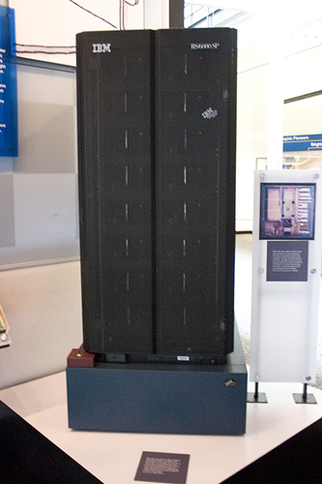

First computer to defeat a world champion!!
Garry Kasparov
Deep Blue
In February 1996, IBM’s Deep Blue defeated grandmaster Garry Kasparov.
It was then assigned to predict the weather in Atlanta, Georgia, during the 1996 Summer Olympic Games

Slide 26
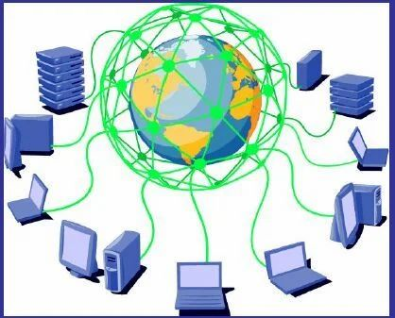
Computing Systems – Grid Computing
Grid Computing:
Allows a group of computers to share the system securely and to optimizes their resources to meet required workloads
A distributed computing system where a group of computers are connected to create and work as one large virtual computing power, storage, database application and services

Slide 27
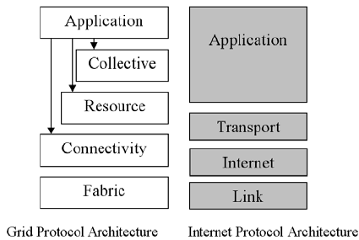
Computing Systems – Grid Computing
Software stack consists of
Standards
Protocols
APIs and SDKs
Loosely based on the internet model
Application: - Protocols targeted at a specific application or class of applications
Collective: - Protocols for systemwide deployment
Resources: - Protocols to initiate and control sharing of local resources ( GRAM, gridFTP, GRIS)
Connectivity:- Protocols for grid specific networks infrastructure (IP,DNS,WSDL); security Implementation (GSI)
Fabric: - protocols and interfaces to resource being shared

Slide 28
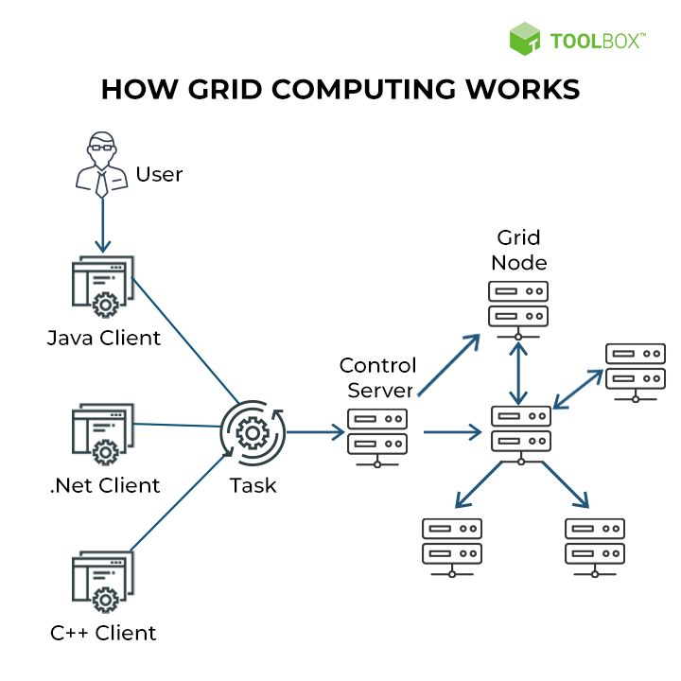
Computing Systems – Grid Computing
A typical grid computing network consists of three machine types:
Control node/server: A control node is a server or a group of servers that administers the entire network and maintains the record for resources in a network pool.
Provider/grid node: A provider or grid node is a computer that contributes its resources to the network resource pool.
User: A user refers to the computer that uses the resources on the network to complete the task.

Slide 29
Computing Systems – Grid Computing
Advantages of Grid Computing:
It is not centralized, as there are no servers required, except the control node which is just used for controlling and not for processing.
Multiple heterogeneous machines i.e. machines with different Operating Systems can use a single grid computing network.
Create flexible, resilient operational infrastructure
Tasks can be performed parallelly across various physical locations and the users don’t have to pay for them.
Enable error recovery and failure
Reduce signal latency
Disadvantages of Grid Computing :
The software of the grid is still in the involution stage.
A super fast interconnect between computer resources is the need of hour.
Licensing across many servers may make it prohibitive for some applications.
Many groups are reluctant with sharing resources .

Slide 30
Computing Systems – Grid Computing
Applications
Life science - the MCell project explores cellular microphysiology using sophisticated ‘Monte Carlo’ diffusion and chemical reaction algorithms to simulate and study molecular interactions inside and outside cells.
Engineering-oriented applications:NASA Information Power Grid (NASA IPG) has deployed large-scale engineering-oriented grid applications in the U.S.
Data-oriented applications DAME is a grid-based distributed diagnostic system for aircraft engines developed in the U.K.
Scientific research collaboration (e-Science)
Commercial applications online gaming and entertainment industry,

Slide 31
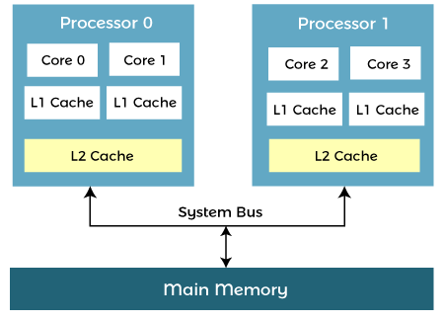
Multi-core processor is a special kind of a multiprocessor: All processors are on the same chip
Computing Systems – Multicore Processor
Multi-core processors are MIMD: Different cores execute different threads (Multiple Instructions), operating on different parts of memory (Multiple Data).
Multi-core is a shared memory multiprocessor: All cores share the same memory
Why multi-core ?
Difficult to make single-core clock frequencies even higher
Deeply pipelined circuits:
heat problems
speed of light problems
Many new applications are multithreaded General trend in computer architecture (shift towards more parallelism)

Slide 32
Computing Systems – Multicore Processor
A multi-core processor is a single computing component with two or more independent actual processing units (called "cores"), which are units that read and execute program instructions.
The instructions are ordinary CPU instructions (such as add, move data, and branch), but the multiple cores can run multiple instructions at the same time, increasing overall speed for programs amenable to parallel computing.
Manufacturers typically integrate the cores onto a single integrated circuit die (known as a chip multiprocessor or CMP), or onto multiple dies in a single chip package.
A multi-core processor implements multiprocessing in a single physical package. Designers may couple cores in a multi-core device tightly or loosely.
For example, cores may or may not share caches, and they may implement message passing or shared memory inter-core communication methods.
Common network topologies to interconnect cores include bus, ring, two-dimensional mesh, and crossbar.

Slide 33
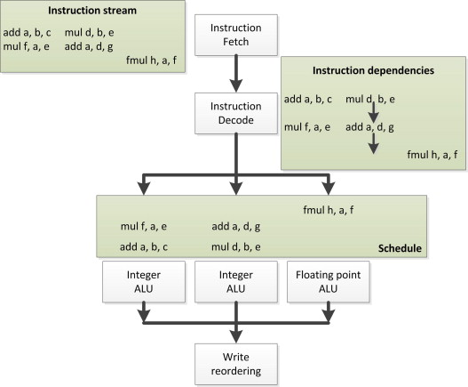
Computing Systems – Multicore Processor
Instruction-level parallelism
Parallelism at the machine-instruction level
The processor can re-order, pipeline instructions, split them into microinstructions, do aggressive branch prediction, etc.
Instruction-level parallelism enabled rapid increases in processor speeds over the last 15 years

Slide 34
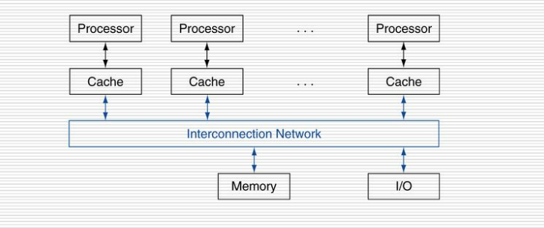
Computing Systems – Multicore Processor
Thread-level parallelism (TLP)
This is parallelism on a more coarser scale
Server can serve each client in a separate thread (Web server, database server)
A computer game can do AI, graphics, and physics in three separate threads
Single-core superscalar processors cannot fully exploit TLP
Multi-core architectures are the next step in processor evolution: explicitly exploiting TLP

Slide 35
Computing Systems – Multicore Processor
Advantages:
Cache coherency – can operate higher clock rate
Signals between different CPU travel shorter distance – hence more data can be transferred
Consume less power than two coupled single core processor
Disadvantages
Performance of the applications depends on the multiple thread within application
Memory bandwidth limits the performance

Slide 36
Computing Systems – Multicore Processor
Multicore Challenges
Relies on exploitation of Multiple thread parallelism
Need for parallel computing model and parallel programming model
Aggravates memory wall
Memory bandwidth
Memory latency
Requires mechanism for efficient inter-processor coordination
Synchronization
Mutual exclusion
Context switching

Slide 37
Computing Systems – Multicore Processor
Applications:
Database server
Webserver
Compiler
Multimedia applications
Scientific application – CAD,CAM

Slide 38
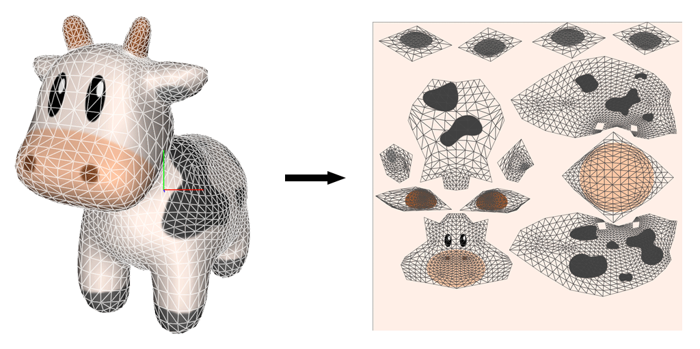
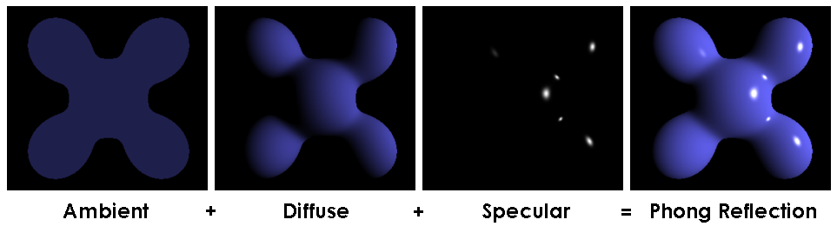
Computing Systems – GPU Systems
Texture mapping
Shading

Slide 39
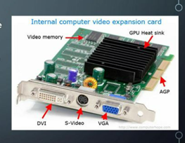
Computing Systems – GPU Systems
GPU
A Graphics Processing Unit or GPU ( Visual Processing Unit) is a dedicated processor for manipulating and displaying computer graphics
Single chip processor
A specific electronic circuit designed for graphics and placed in video card
Why GPU
To provide a separate dedicated graphics resources including a graphics processor and memory
GPU Vs CPU
GPU – Mainly parallel operation while CPU -Serial operation
GPU faster and advanced memory interfaces

Slide 40
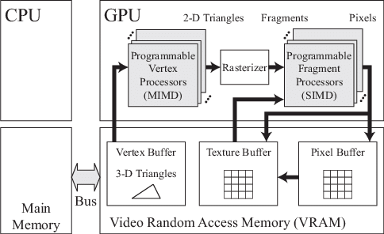
Computing Systems – GPU Systems

Slide 41
Computing Systems – GPU Systems
Advantages:
High Data Throughput: a GPU consist of hundreds of cores performing the same operation on multiple data items in parallel. Because of that, a GPU can push vast volumes of processed data through a workload, speeding up specific tasks beyond what a CPU can handle.
Massive Parallel Computing: Whereas CPUs excel in more complex computations, GPUs excel in extensive calculations with numerous similar operations, such as computing matrices or modeling complex systems.
Disadvantages :
Multitasking—GPUs can perform one task at massive scale, but cannot perform general purpose computing tasks.
Cost—Individual GPUs are currently much more expensive than CPUs.

Slide 42
Computing Systems – GPU Systems
Application
GPUs can process many pieces of data simultaneously, making them useful for machine learning, video editing, and gaming applications.

Slide 43
Computing Systems – Petascale Systems
one petaflop per second is a rate of computation corresponding to 10¹⁵
floating-point operations per second.

Slide 44
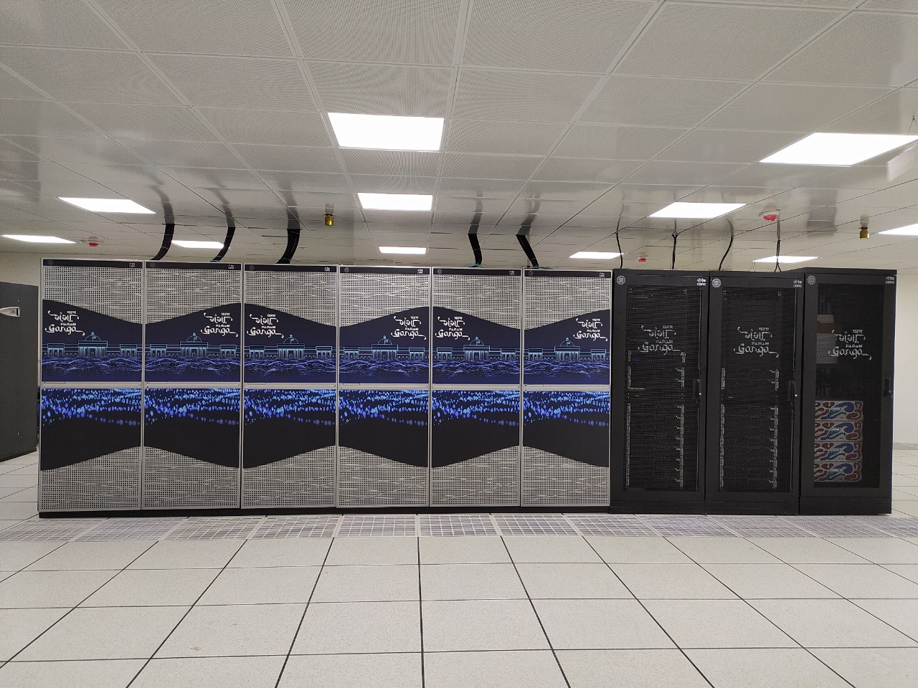
Computing Systems – Petascale Systems
A Made in India Petascale Supercomputer “PARAM Ganga” has been installed at IIT Roorkee on Monday by B.V.R. Mohan Reddy, Chairman, Board of Governors, Indian Institute of Technology (IIT) Roorkee.
The establishment of 1.66 PFLOPS (Peta Floating-Point Operations Per Second)

Slide 45
Computing Systems – Petascale Systems
applications
•nuclear weapons stewardship,
•cryptology,
•climate and environmental modeling,
•3D protein molecule reconstruction,
•severe storm forecasting,
•design of advanced aircraft,
•molecular nanotechnology,
•intelligent planetary spacecraft, and
•real-time medical imaging.

Slide 46
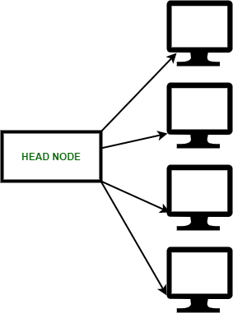
Computing Systems – Cluster Computing
Cluster Computer
A cluster is a type of parallel and distributed system, which consists of a collection of inter- connected stand-alone computers working together as a single integrated computing resource.
A computer node can be a single or multi-processor system such as PCs, workstations, servers, SMPs with memory, I/O and an OS.
It is a group of workstations or computers working together as a single, integrated computing resource connected via high speed interconnects.
The nodes are interconnected via a LAN.

Slide 47
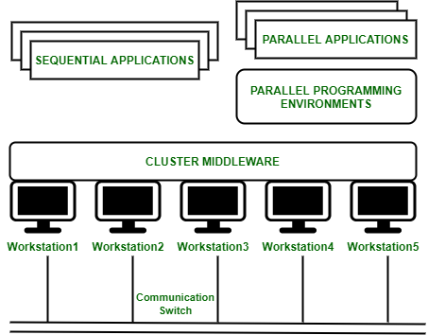
Computing Systems – Cluster Computing
Cluster Computing Architecture :
It is designed with an array of interconnected individual computers and collectively operate as a single standalone system.
A node – Either a single or a multiprocessor network having memory, input and output functions and an operating system.
Two or more nodes are connected on a single line or every node might be connected individually through a LAN connection.

Slide 48
Computing Systems – Cluster Computing
The cluster components are as follows.
Multiple High Performance Computers
Oss (Layered or Micro-Kernel Based)
High Performance Networks or Switches (Gigabit Ethernet and Myrinet)
Network Interface Cards (NICs)
Fast Communication Protocols and Services (Active and Fast Messages)
Cluster Middleware (Single System Image (SSI) and System Availability Infrastructure)
Parallel Programming Environments and Tools (Parallel Virtual Machine (PVM), Message Passing Interface (MPI))
Applications (Sequential, Parallel or Distributed)

Slide 49
Computing Systems – Cluster Computing
Cluster Classifications
The various features of clusters are as follows.
High Performance
Expandability and Scalability
High Throughput
High Availability
Load Balancing

Slide 50
Computing Systems – Cluster Computing
Cluster can be classified into many categories as follows.
Application Target
High Performance Clusters (HP) – Parallel Computing
High Availability Clusters (HA) – integrates performance and availability into a single system
Node Ownership
Dedicated Clusters – individual does not own any workstations (resources are shared across the clusters
Nondedicated Clusters (Adaptive parallel computing) – idle CPU cycles
Node Hardware
Cluster of PCs (CoPs) or Piles of PCs (PoPs)
Cluster of Workstations (COWs)
Cluster of SMPs (CLUMPs)

Slide 51
Computing Systems – Cluster Computing
4. Node OS
Linux Clusters (Beowulf)
Solaris Clusters (Berkeley NOW)
NT Clusters (High Performance Virtual Machine (HPVM))
Advanced Interactive eXecutive (AIX) Clusters (IBM Service Pack 2 (SP2))
Digital Virtual Memory System (VMS) Clusters
HP-UX Clusters
Microsoft Wolfpack Clusters
5. Node Configuration
Homogeneous Clusters –similar architecture and same OS
Heterogeneous Clusters – different architecture and different OS
6. Levels of Clustering
Group Clusters (No. of Nodes = 2 to 99)
Departmental Clusters (No. of Nodes = 10 to 100s)
Organizational Clusters (No. of Nodes = Many 100s)
National Metacomputers (No. of Nodes = Many Departmental or Organizational Systems or Clusters)
International Metacomputers (No. of Nodes = 1000s to Many Millions)

Slide 52
Computing Systems – Cluster Computing
Components for Clusters
The components of clusters are the hardware and software used to build clusters and nodes. Processors
Microprocessor Architecture (RISC, CISC, VLIW and Vector)
Intel x86 Processor (Pentium Pro and II)
Pentium Pro shows a very strong integer performance in contrast to Sun’s UltraSPARC for high performance range at the same clock speed. However, the floating-point performance is much lower.
The Pentium II Xeon uses a memory bus of 100 MHz. It is available with a choice of 512 KB to 2 MB of L2 cache.
Other processors: x86 variants (AMD x86, Cyrix x86), Digital Alpha, IBM PowerPC, Sun SPARC, SGI MIPS and HP PA.
Berkeley uses Sun’s SPARC processors in their cluster nodes.
Memory and Cache
The memory present inside a PC was 640 KBs. Usually, a PC is delivered with 32 or 64 MBs installed in slots with each slot holding a Standard Industry Memory Module (SIMM).
Cache is used to keep recently used blocks of memory for very fast access. The size of cache is usually in the range of 8KBs to 2MBs.

Slide 53
Computing Systems – Cluster Computing
3. Disk and I/O
The I/O performance is improved to carry out I/O operations in parallel. It is supported by parallel file systems based on hardware or software Redundancy Array of Inexpensive Disk (RAID).
Hardware RAID is more expensive than Software RAID.
4. System Bus
The initial PC bus has a clock speed of 5 MHz and it is 8 bits wide.
In PCs, the ISA bus is replaced by faster buses such as PCI.
The ISA bus is extended to be 16 bits wide and an enhanced clock speed of 13 MHz. However, it is not sufficient to meet the demands of the latest CPUs, disk and other components.
The VESA local bus is a 32 bit bus that has been outdated by the Intel PCI bus.
PCI bus allows 133 Mbytes/s.

Slide 54
Computing Systems – Cluster Computing
5. Cluster Interconnects
The nodes in a cluster are interconnected via standard Ethernet and these nodes are communicated using a standard networking protocol such as TCP/IP or a low-level protocol such as Active Messages.
Ethernet: 10 Mbps
Fast Ethernet: 100 Mbps
Gigabit Ethernet
The two main characteristics of Gigabit Ethernet are as follows.
It preserves Ethernet’s simplicity which enabling a smooth migration to Gigabit-per-second (Gbps) speeds.
It delivers a very high bandwidth to aggregate multiple Fast Ethernet segments.
Asynchronous Transfer Mode (ATM)
It is a switched virtual-circuit technology.
It is intended to be used for both LAN and WAN, presenting a unified approach to both.
It is based on small fixed-size data packets termed cell. It is designed to allow cells to be transferred using a number of medias such as copper wire and fiber optic cables.
CAT-5 is used with ATM allowing upgrades of existing networks without replacing cabling.

Slide 55
Computing Systems – Cluster Computing
Scalable Coherent Interface (SCI)
It aims to provide a low-latency distributed shared memory across a cluster.
It is design to support distributed multiprocessing with high bandwidth and low latency.
It is a point-to-point architecture with directory-based cache coherence.
Dolphin has produced an SCI MPI which offers less than 12 µs zero message- length latency on the Sun SPARC platform.
Myrinet
It is a 1.28 Gbps full duplex interconnection network supplied by Myricom .
It uses low latency cut-through routing switches, which is able to offer fault tolerance.
It supports both Linux and NT.
It is relatively expensive when compared to Fast Ethernet, but has following advantages. 1) Very low latency (5 µs), 2) Very high throughput, 3) Greater flexibility.
The main disadvantage of Myrinet is its price. The cost of Myrinet-LAN components including the cables and switches is $1,500 per host. Switches with more than 16 ports are unavailable. Therefore, scaling is complicated.

Slide 56
Computing Systems – Cluster Computing
6. Operating Systems
Linux :
wide range of software tools, libraries, and utilities available
Supports preemptive multitasking, demand-paged virtual memory, multiuser, and multiprocessor support
Linux kernel, a large amount of application/systems software is also freely available, including GNU software and XFree86, a public domain X-server
Solaris :
Solaris supports distributed computing and is able to store and retrieve distributed information to describe the system and users through the Network Information Service (NIS) and database.
Windows NT :
Packaged with Windows NT are several built-in networking protocols, such as IPX/SPX, TCP/IP, and NetBEUI and APIs, such as NetBIOS, DCE RPC, and Windows Sockets (WinSock).
TCP/IP applications use WinSock to communicate over a TCP/IP network.

Slide 57
Computing Systems – Cluster Computing
Advantages :
High Performance
Easy to manage
Scalable
Expandability
Availability
Flexibility
Disadvantages :
High cost
Problem in finding fault
More space is needed

Slide 58
Computing Systems – Cluster Computing
Applications of Cluster Computing :
Various complex computational problems can be solved.
It can be used in the applications of aerodynamics, astrophysics and in data mining.
Weather forecasting.
Image Rendering.
Various e-commerce applications.
Earthquake Simulation.
Petroleum reservoir simulation.

Slide 59
Thank You

